Slide 1

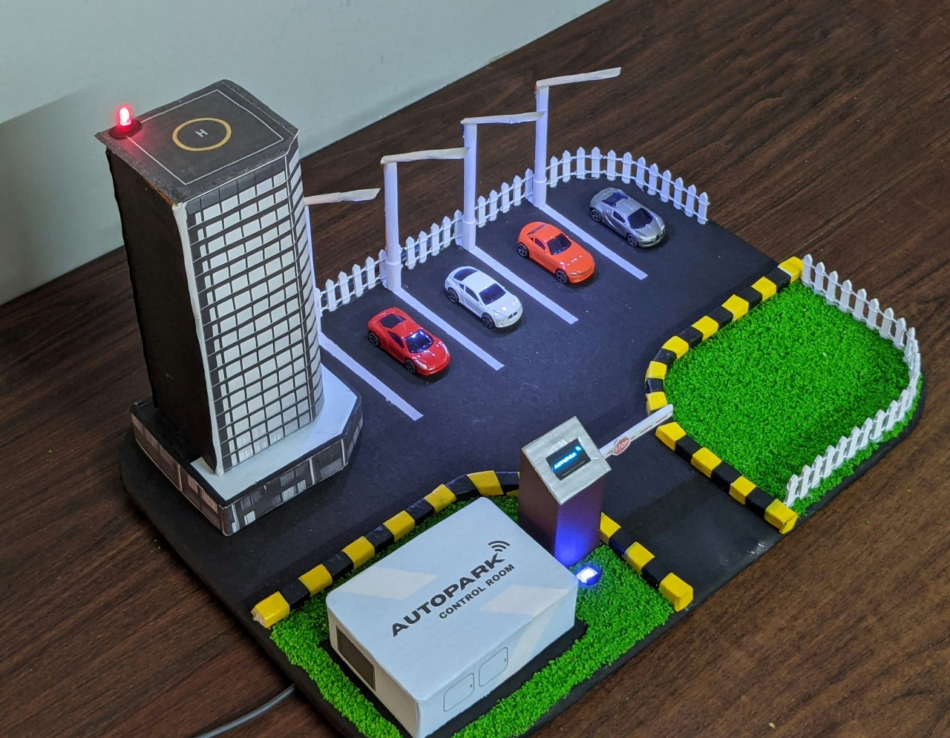
AUTOPARK
A NEXT-GEN
PARKING SOLUTION
IoT Based Smart Parking System

Slide 2


Abstract
Urban parking congestion, largely driven by rising vehicle density, causes over 30% of city traffic and results in significant economic losses due to fuel waste and delays. Existing systems relying on manual management or RFID face issues like inefficiency, human error, and security risks. To tackle this, we developed AUTOPARK—an IoT-powered smart parking system designed for seamless vehicle authentication, real-time slot tracking, and contactless payments. AUTOPARK enhances security, automates operations, and improves space utilization, making it ideal for scalable deployment in smart cities. This project not only delivered technical improvements but also strengthened our skills in teamwork, problem-solving, and project execution.

Slide 3

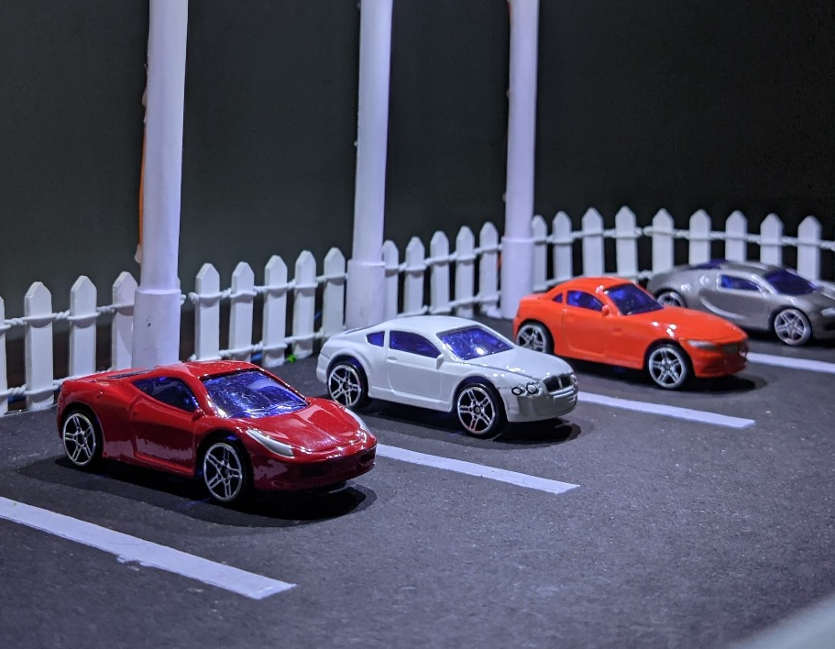
Contents
• | Problem Statement
• | Introduction
• | Comparison
• | Hardware Layer
• | Communication Layer
• | Application Layer
• | Methodology
• | Workflow & Algorithms
• | Implementation & Results
• | Website Implementation
• | Prototype Illustration
• | Challenges & Limitations
• | Future Scope
• | Conclusion
• | References

Slide 4
Problem statement
Urban areas face severe parking inefficiencies, causing traffic congestion and revenue losses.
Manual systems are prone to human errors, unauthorized parking, and fraud.
RFID-based systems, while more secure, suffer from high costs, cloning risks, and maintenance issues.

Slide 5
Introduction
To address the mentioned problems, we present AUTOPARK, an IoT-driven smart parking solution designed for automation, affordability, and scalability. It uses ESP8266 microcontrollers, IR sensors, servo motors, and QR code-based authentication to fully automate entry, exit, slot monitoring, and billing.
Users scan a unique QR code for access, with real-time slot availability shown on OLED displays and a cloud dashboard. Exit is similarly automated, with fees calculated based on parking duration. This reduces manual intervention, unauthorized access, and operational costs.

Slide 6
Comparing with existing systems
Cost Analysis:
RFID vs. IoT
Efficiency
Metrics
Scalability
Response Time:
IoT: 45% faster entry/exit
Automation: Higher in IoT-based systems
Security: RFID more secure unless IoT uses enhanced encryption
RFID: Costly, infrastructure-heavy for dense areas
IoT: Easily scalable; modular expansion
Real-world examples: Madrid, Tokyo — 60% better space utilization with AI
RFID: $50–$70 per vehicle; high maintenance (tag replacement, recalibration)
IoT (ESP8266 + IR sensors): ~30% lower cost; minimal maintenance

Slide 7
Hardware Layer (1/2)
IR Sensor Module
Detects vehicle presence (range: 2–30 cm)
Operates at 3.3V–5V with <1 ms response time
Real-time parking slot occupancy detection
Servo Motor Module
Controls entry/exit gates
Torque: 2.5–10 kg/cm | Voltage: 4.8V–6V
Rotational range: 0–180° for barrier movement
Triggered after QR code verification
Parking Slot Detection System
1 ESP8266 + 4 IR sensors + OLED display
Detects and shows real-time slot availability
Pin configuration mapped to GPIO pins (refer to table)
OLED Display Module
0.96” or 1.3” screen, 128x64 resolution
Supports I2C/SPI interfaces
Displays real-time parking data and animations
Connectors, Adapter & LEDs
Connectors: Insulated copper wires for stable signals
DC Adapter: 5V regulated power for system components
LEDs: Green = Available, Red = Occupied slots
Gate Control System Pin Configuration
ESP8266 connected to servo motor for gate control
Dedicated GPIO pins for servo and IR input
Ensures responsive gate operation

Slide 8
Hardware Layer (2/2)
AUTOPARK OLED Animation
Displays animation of approaching car
Branding text: “Next-Gen Parking System”
Shows live status of parking slots
Circuit Diagram & Dual ESP8266 Setup
ESP8266 (1): Handles display + slot detection
ESP8266 (2): Manages gate control + web communication
ESP8266 Microcontroller Module
Acts as central control unit
Wi-Fi-enabled 32-bit RISC processor (80–160 MHz)
64 KB SRAM, 4 MB Flash Memory
Supports Wi-Fi 802.11 b/g/n with WPA/WPA2
Ultra-low power consumption; ideal for IoT

Slide 9
Communication layer
01
Enables seamless data exchange between hardware, cloud, and users
02
Ensures secure and real-time system responsiveness
Wireless Communication
Cloud Integration
Uses Wi-Fi (802.11 b/g/n) via ESP8266 module
Supports HTTP requests (web communication)
Uses MQTT protocol for low-latency messaging
Ensures data security with TLS/SSL encryption
Provides real-time, efficient data transfer
Supports Firebase / AWS for cloud database storage
Real-time sync of parking slot data to users
Uses JSON format for efficient data handling
Optimized protocols to reduce bandwidth and latency
Ensures fast, secure, and scalable communication

Slide 10
Application layer
01
Manages user interface, data processing, and analytics
07
OLED display & cloud dashboard show live slot status
02
Users register via web portal → Unique QR code generated
08
Auto billing system calculates charges based on duration
03
Admin scans QR code to authorize entry/exit
09
Supports digital payments: Credit Card, UPI, Wallets
04
Servo motor triggered on successful verification
10
Web app shows: slot availability, transaction history, cost estimate
05
Entry/exit timestamps recorded for billing
11
User Site: autoparkltd.netlify.app
06
IR sensors monitor slots in real time
12
Admin Site: autoparkadmin.netlify.app

Slide 11

Methodology
Step 1: Requirements Gathering
Urban parking needs analysis
Defined scope: real-time monitoring, automation, reduced congestion
Step 3: Software & Cloud Integration
Web app for user/admin interface (HTML, CSS, JS)
Firebase/AWS for real-time data sync and storage
Secure API-based communication
Step 5: QR Code Authentication
Unique, encrypted QR for each user
HTTPS-secured admin scanning and access control
Step 7: Billing & Payment System
Entry/exit time tracking
Auto bill generation with UPI, card, wallet payments
01
02
03
04
05
06
07
08
Step 2: Hardware Design & Selection
ESP8266 for Wi-Fi and low power use
IR sensors for vehicle detection
OLED display for slot status
Servo motors for automated gate control
LEDs and power modules for reliability
Step 4: Integration & Testing
Hardware-software sync (IR, OLED, QR, servo)
Functional + integration testing for performance
Step 6: Real-Time Slot Detection
IR sensors → ESP8266 → Cloud → Web + OLED update
Step 8: Final Testing & Deployment
Real-world deployment + continuous monitoring
User feedback loop for refinement and optimization

Slide 12
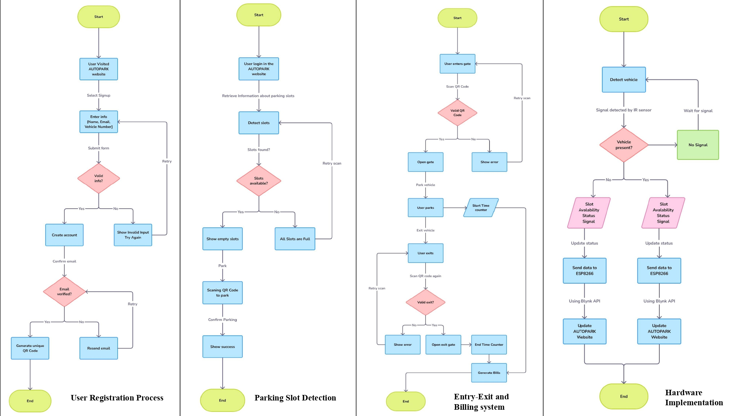
Workflow

Slide 13
Algorithms (1/2)
Algorithm of User Registration Process
Algorithm of Parking Slot Detection
Start
User visits AUTOPARK website
Select "Signup"
Enter information: Name, Email, Vehicle Number
Submit form
Check if information is valid:
If No: Show "Invalid Input", Retry
If Yes: Proceed
Create account
Confirm email
Check if email is verified:
If No: Resend email, Retry
If Yes: Proceed
Generate unique QR Code
End
Start
User logs in to AUTOPARK website
Retrieve parking slot information
Detect slots
Check if slots are found:
If No: Retry slot detection
If Yes: Proceed
Check if slots are available:
If No: Show "All slots are full", End
If Yes: Proceed
Show empty slots
User parks and scans QR Code
Confirm parking
Show success
End

Slide 14
Algorithms (2/2)
Algorithm of Entry-Exit and Billing System
Algorithm of Hardware Implementation
Start
User enters gate
Scan QR Code
Check if QR Code is valid:
If No: Show error, Retry
If Yes: Open gate
User parks vehicle
Start time counter
User exits vehicle
User exits parking
Scan QR Code again
Check if QR Code is valid for exit:
If No: Show error, Retry
If Yes: Open exit gate
End time counter
Generate bill
End
Start
Detect vehicle using IR sensor
Wait for IR signal
Check if vehicle is present:
If No: Update status: Slot available
If Yes: Update status: Slot occupied
Send slot status data to ESP8266
Use Blynk API to update AUTOPARK website
End

Slide 15
Implementation
Hardware Integration
Components: ESP8266, IR sensors, OLED, servo motors, 5V DC power supply
Arduino IDE used for microcontroller programming
Servo motors control gates based on QR code authentication
Network & Cloud Connectivity
ESP8266 enables Wi-Fi data transfer
Firebase used for real-time database and synchronization
Secure API endpoints manage communication between system and cloud
Web Application Development
Built using HTML, CSS, JS, Node.js, Express.js
Functions: user registration, QR generation, slot monitoring, online payment
Security Measures
QR codes encrypted
HTTPS enforced for all data transfers
Anomaly detection alerts for suspicious activities
System Testing
Functional, load, and network security tests conducted
Performance evaluated for multi-user scenarios

Slide 16
Results
System Performance
Real-time vehicle detection with <1 sec response time
Smooth gate automation using QR authentication
OLED displays show live parking status
Cloud & Admin Efficiency
Remote access to parking records and transaction logs
Centralized dashboard for monitoring and reporting
Security and Stability
Encrypted QR codes prevent unauthorized access
HTTPS and anomaly detection enhance data protection
User Experience
Easy registration, real-time slot updates, secure digital payments
Positive feedback for system speed and reliability
Improvement Areas
Occasional sync delays due to network issues
Future updates: edge computing & AI-based predictive analytics

Slide 17
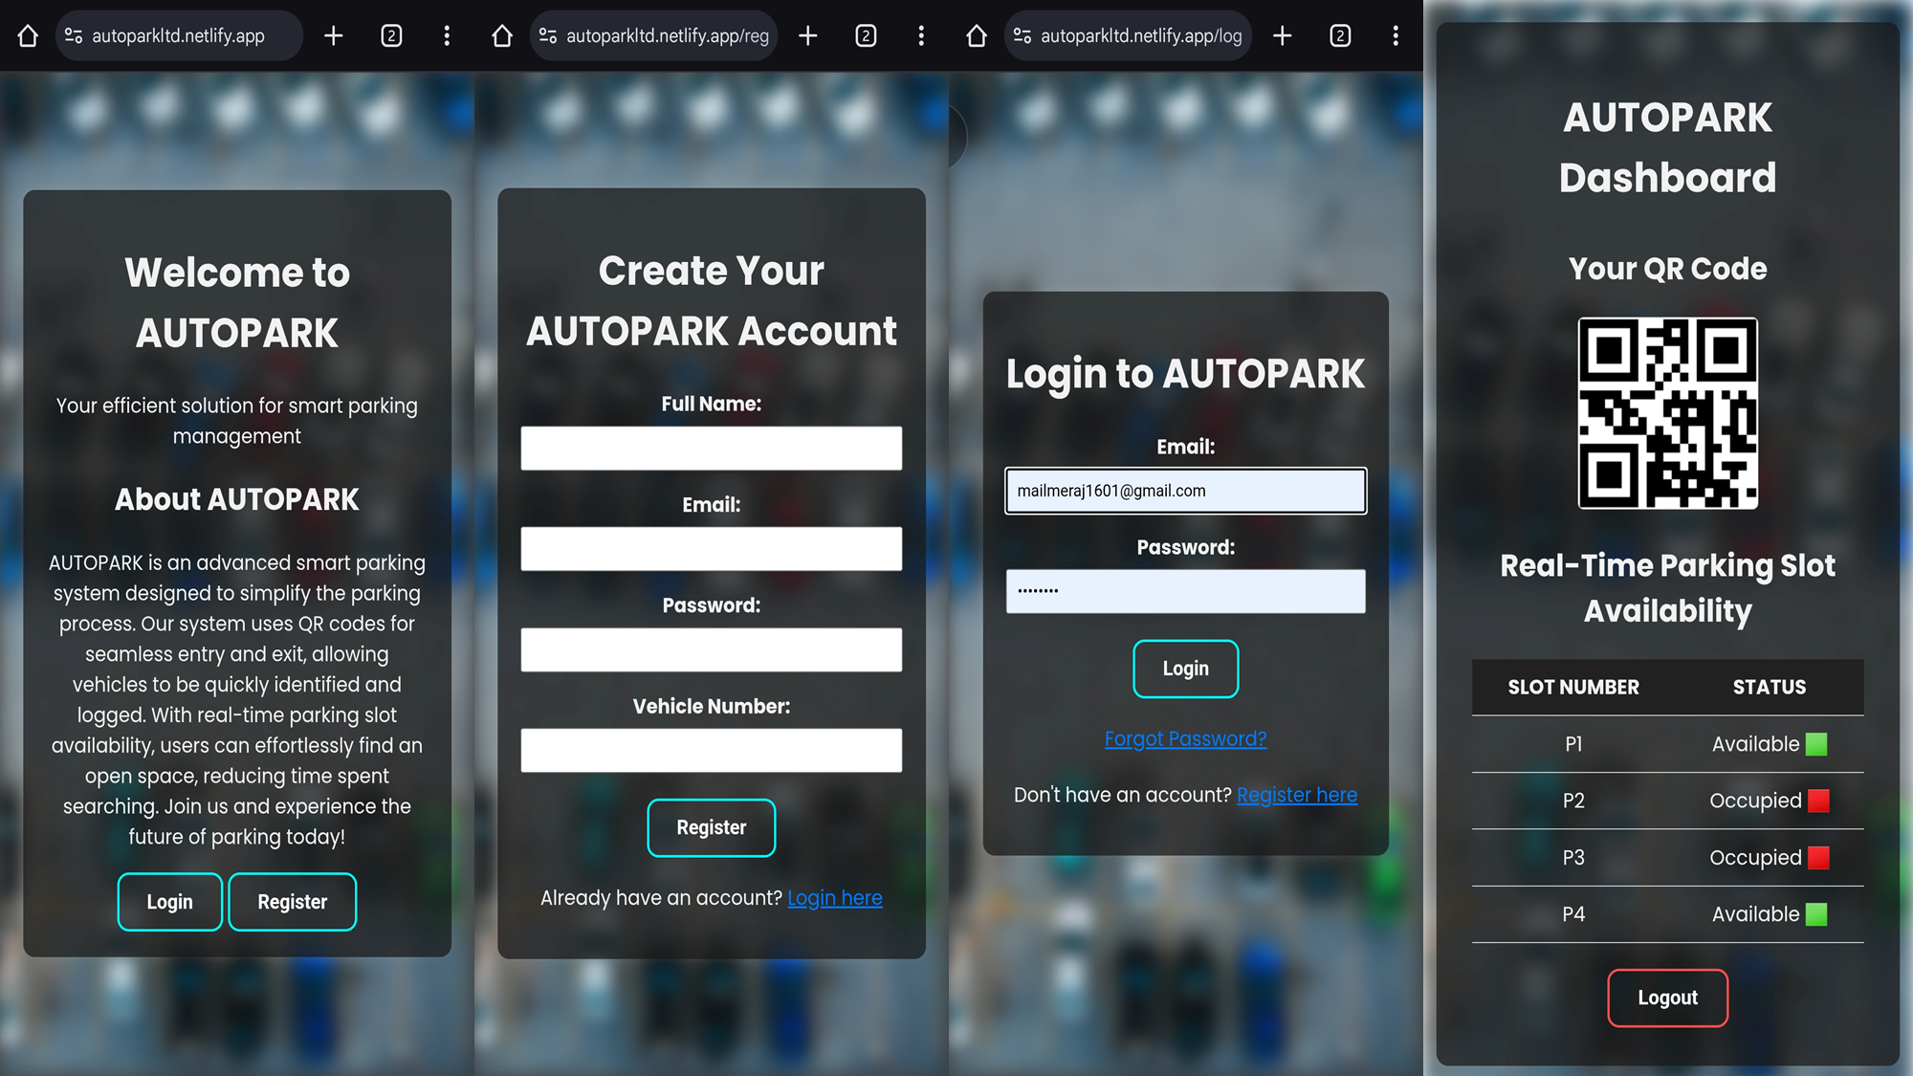
Registration Process of Autopark

Slide 18
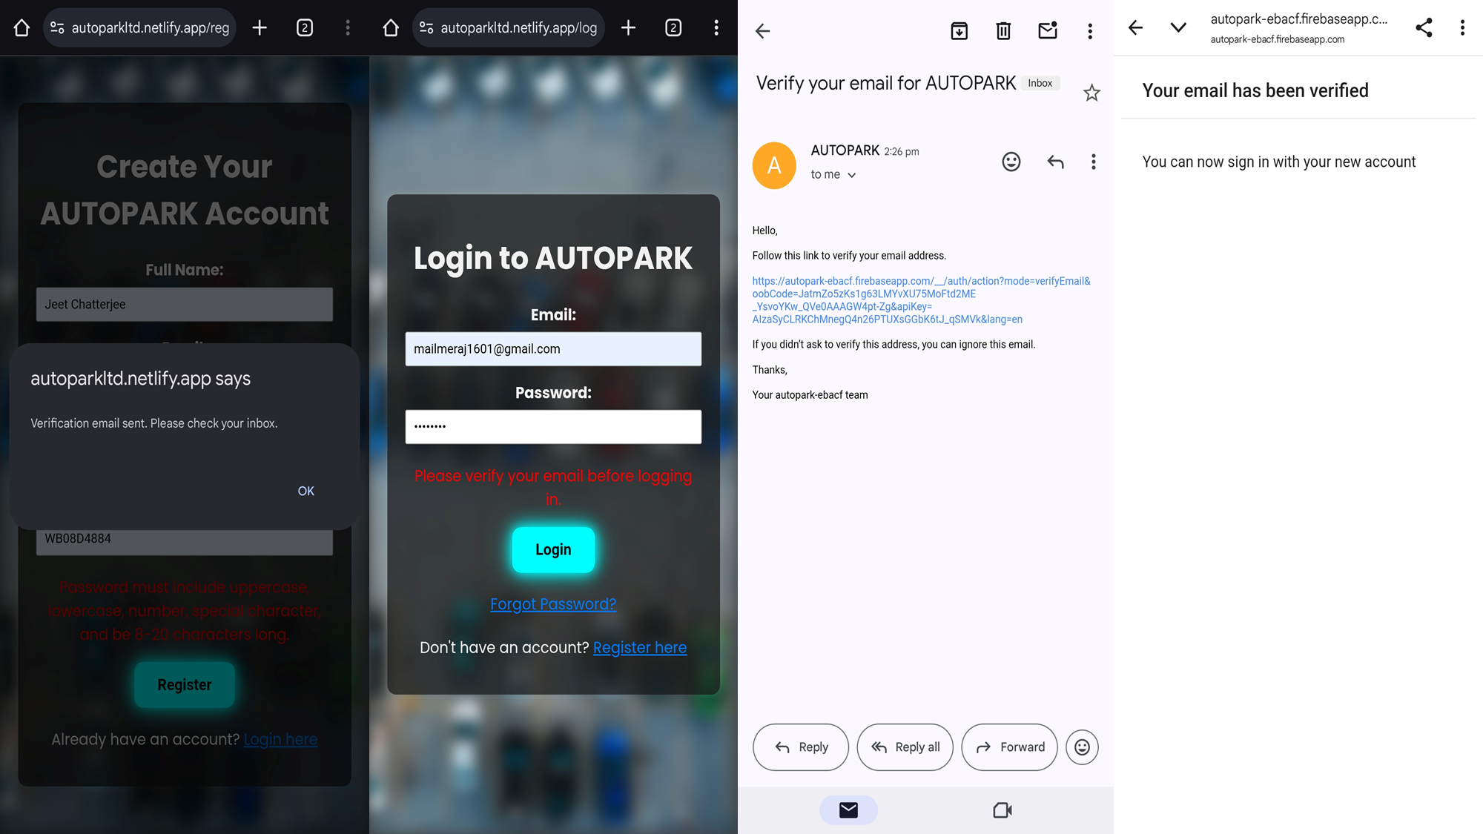
Email Verification Process of Autopark

Slide 19
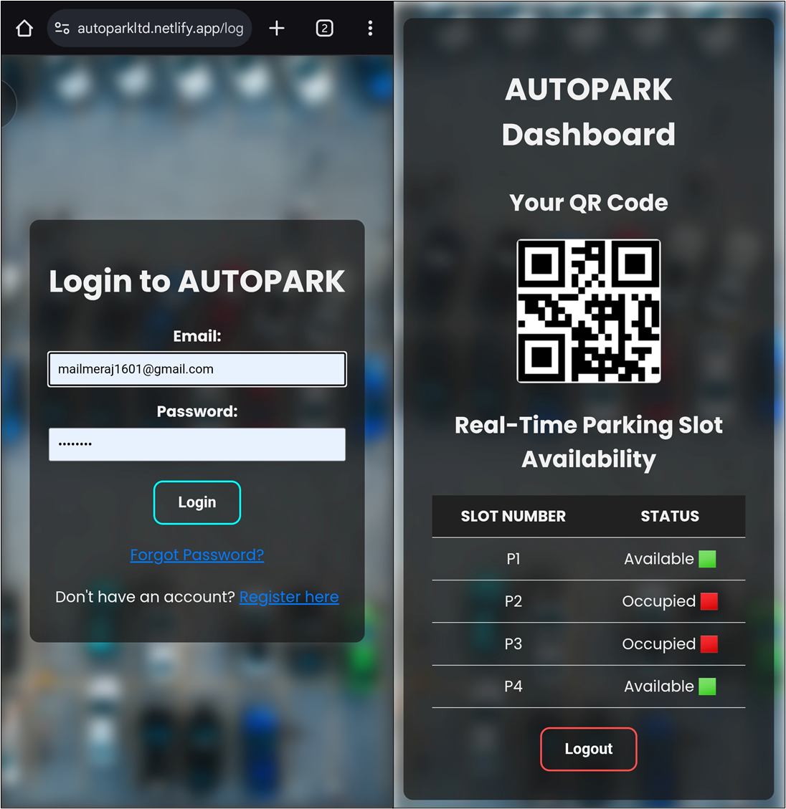
Login to Autopark

Slide 20
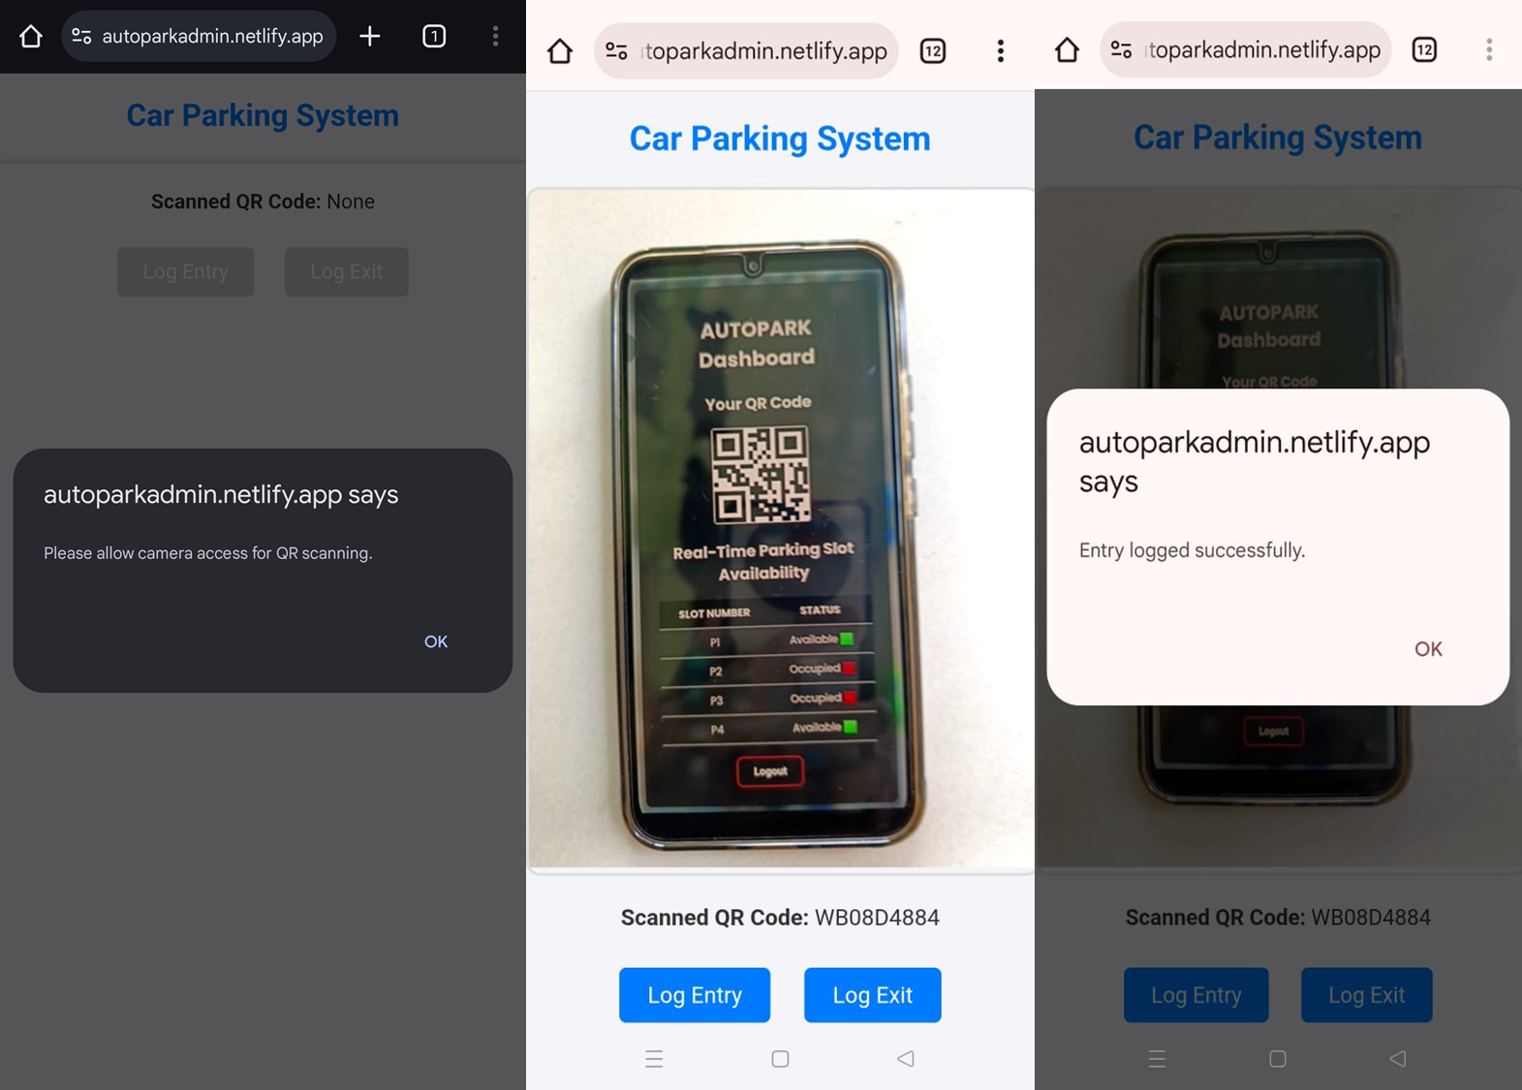
Autopark Log Entry Page

Slide 21
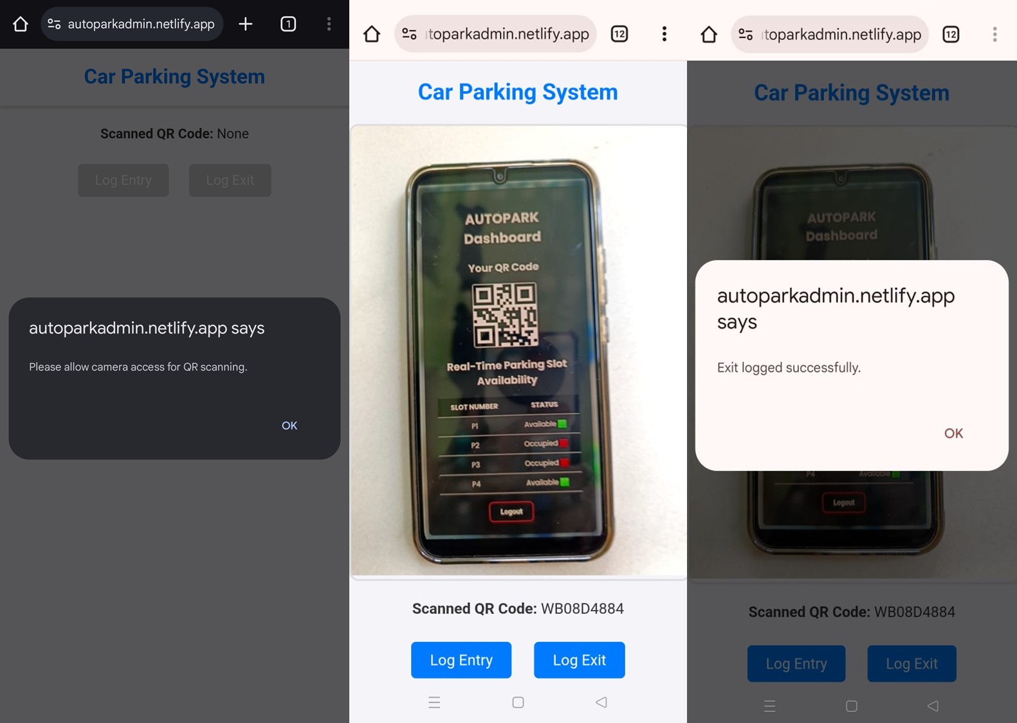
Autopark Log Exit Page

Slide 22
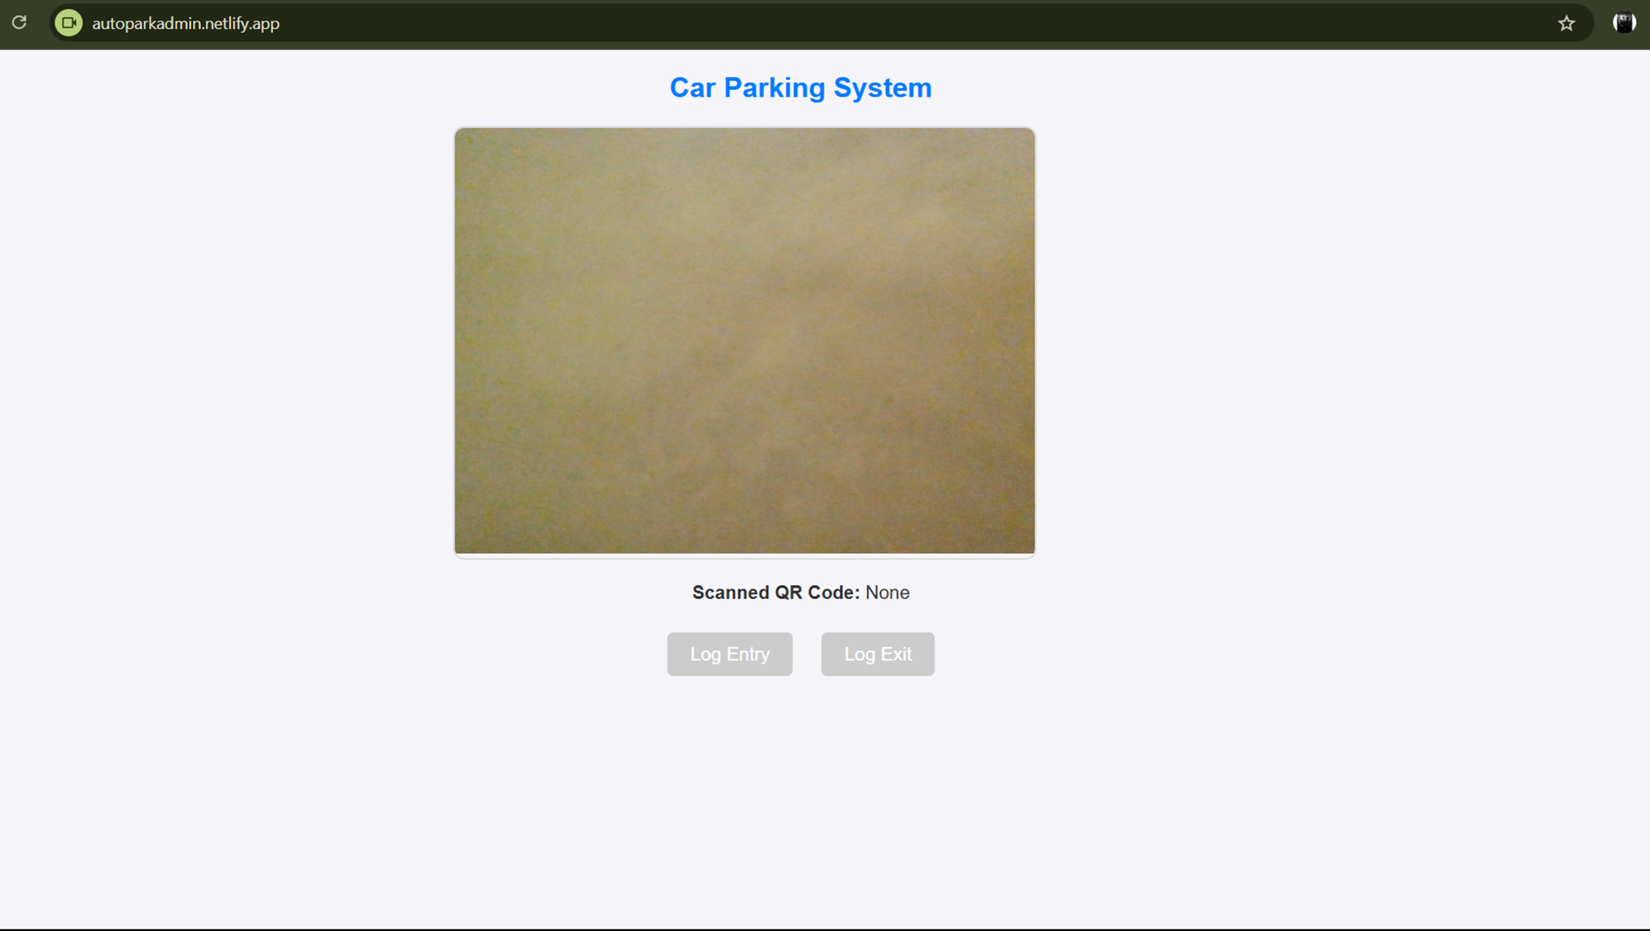
Autopark Admin Interface

Slide 23
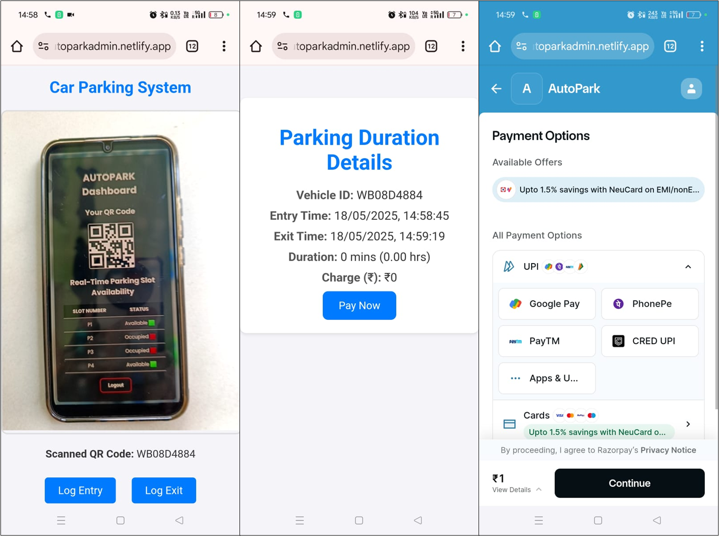
Autopark Payment Gateway

Slide 24
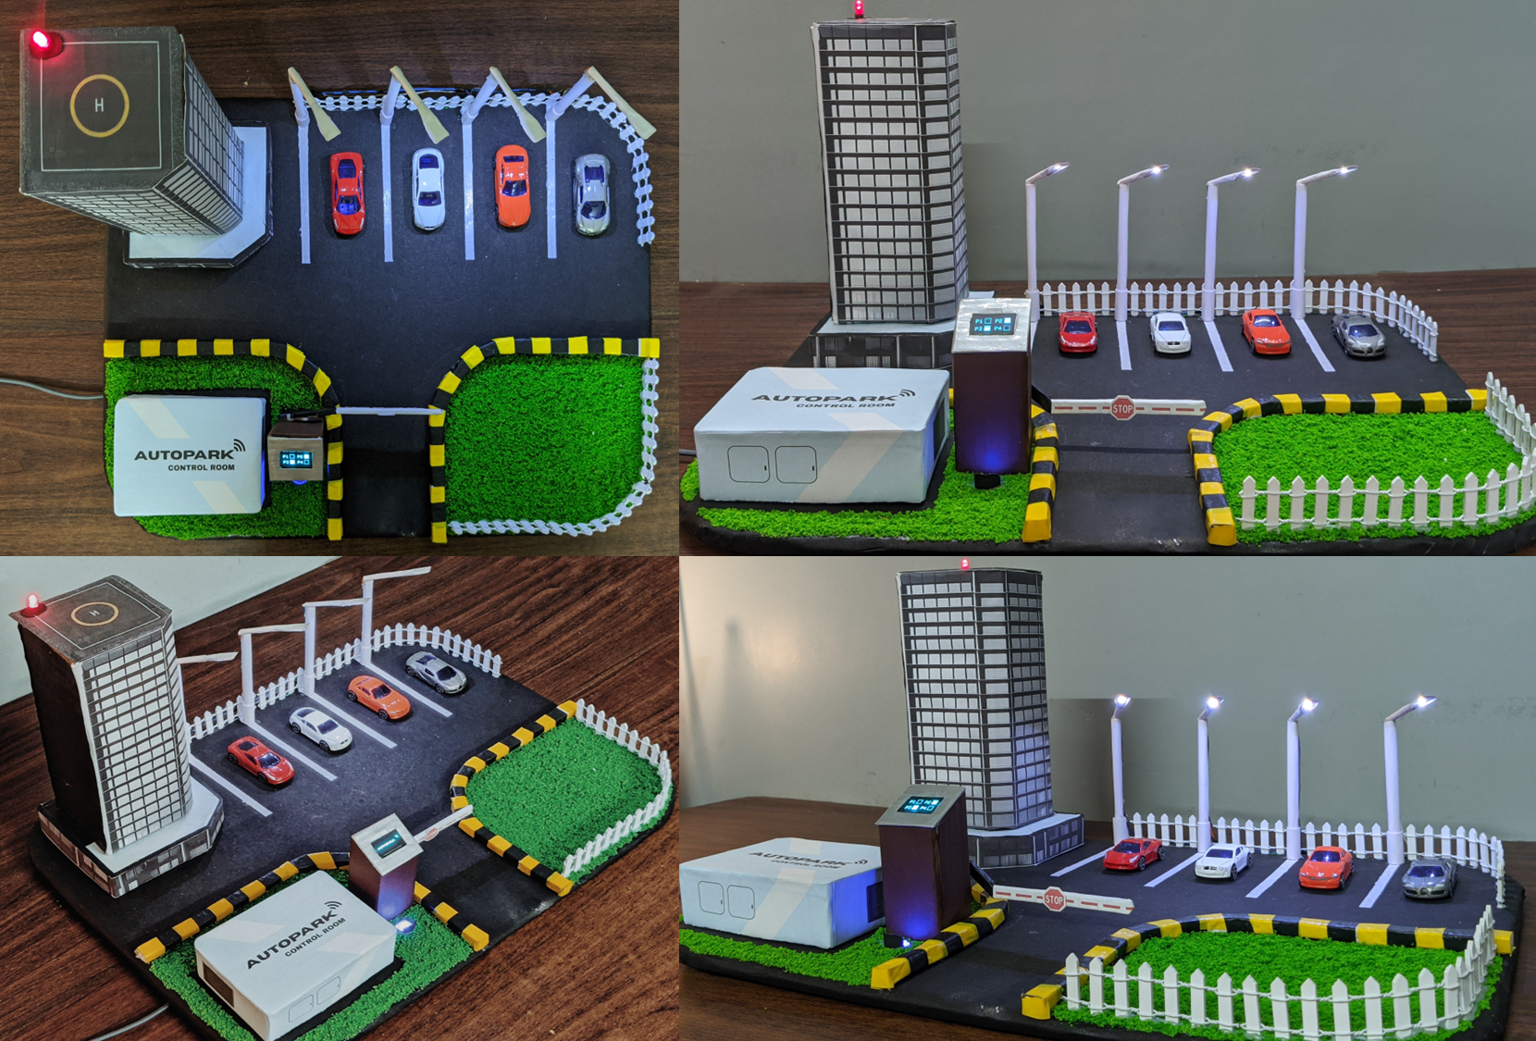
Prototype Illustration

Slide 25
Challenges and limitations
01
Infrastructure & Deployment
04
Security & Privacy
Challenge: Retrofitting outdated facilities; high initial cost
Implementation: Modular hardware design & phased deployment
Challenge: QR code forgery, data breaches
Implementation: End-to-end encryption & multi-factor authentication
02
Network Reliability & Latency
05
Cost & Maintenance
Challenge: Unstable Wi-Fi, latency issues
Implementation: Use of mesh networks & hybrid communication models
Challenge: High setup cost for small entities
Implementation: Open-source platforms & predictive maintenance tools
03
Sensor Accuracy & Environment
06
User Adoption
Challenge: Weather interference, dust accumulation
Implementation: Regular maintenance & adaptive calibration
Challenge: Resistance from low digital literacy regions
Implementation: Intuitive UI/UX & awareness campaigns
Future Vision
AI-driven slot reservation, blockchain security, voice navigation

Slide 26
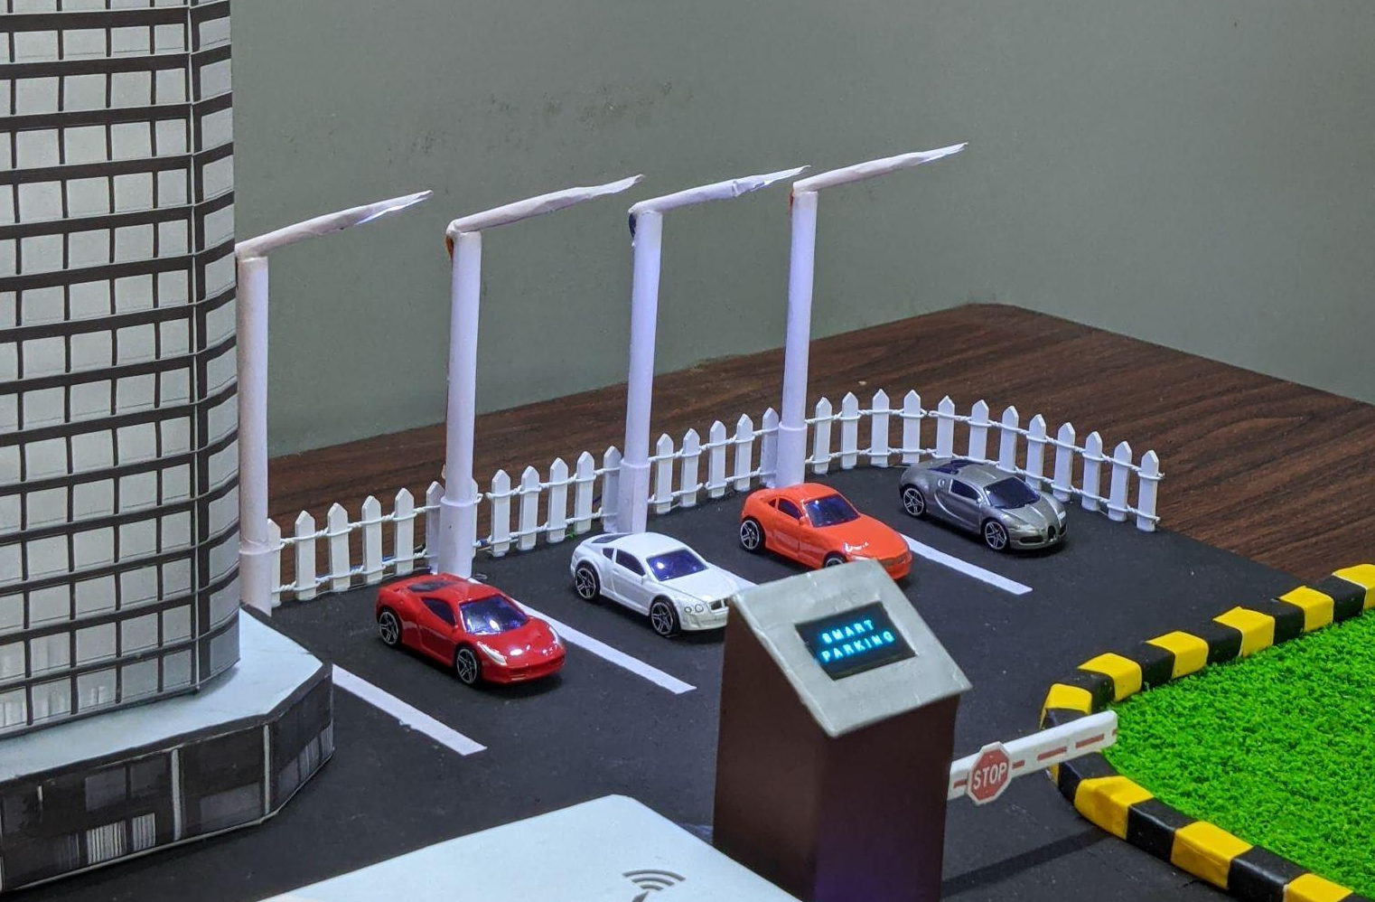
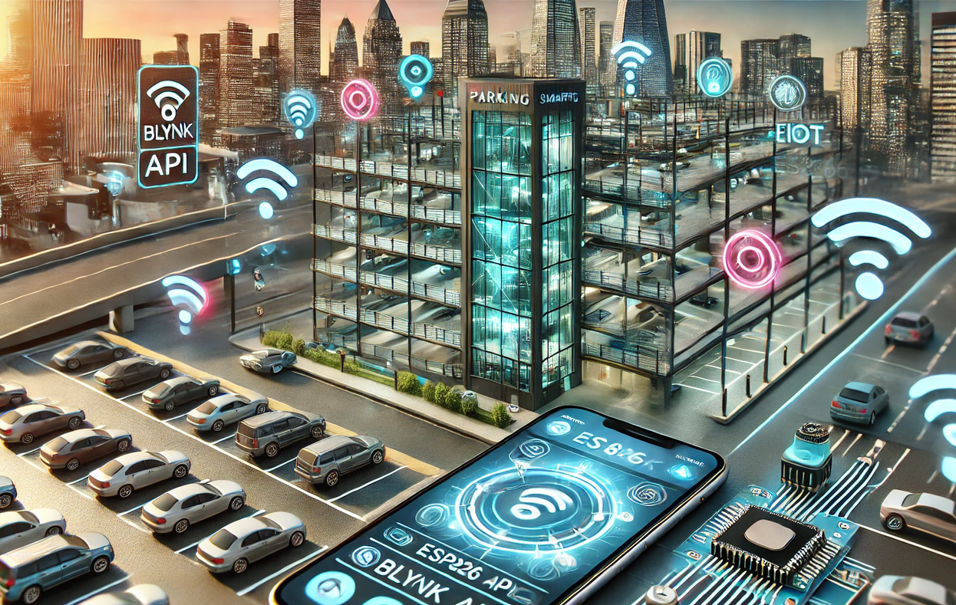
Future Scope
Integration with Payment Systems
Mobile App Development
Advanced sensors and machine learning
Real time parking slot reservation
Integration with smart city platforms

Slide 27
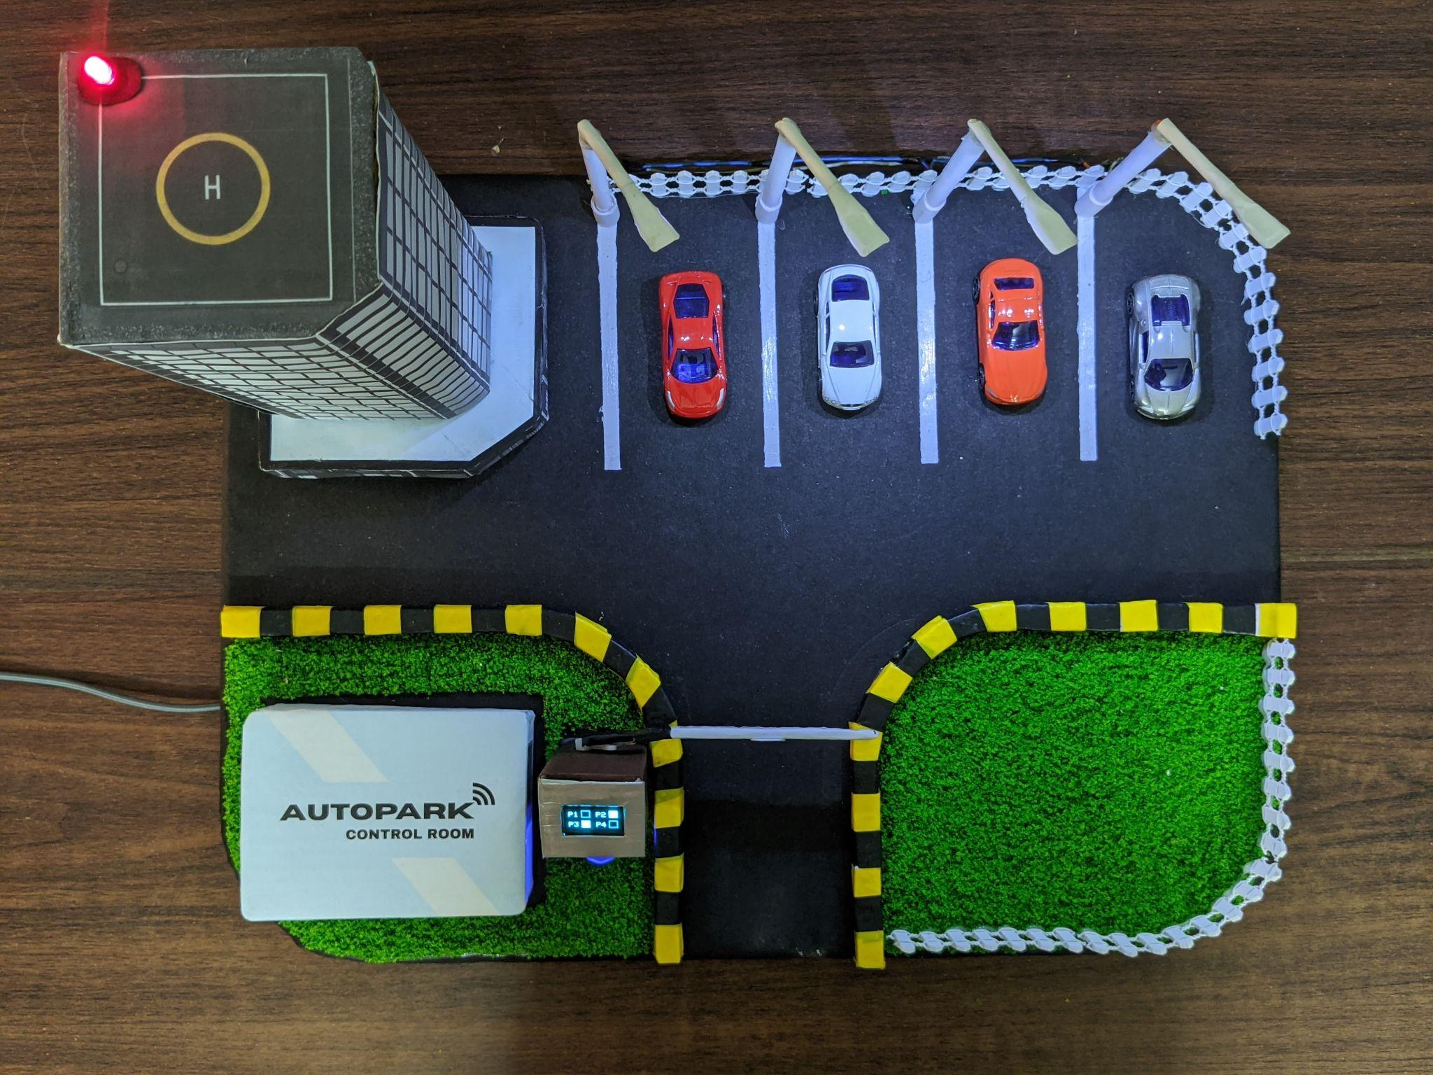
Conclusion
Revolutionizing Parking with IoT:
Combines ESP8266 and Blynk app for real-time parking management.
Enhances convenience, efficiency, and user accessibility.
Scalable and Sustainable:
Adaptable for residential, commercial, and public parking needs.
Supports smart city goals by reducing fuel consumption and emissions.
Future-Ready Innovation:
Opportunities to integrate AI for predictive parking and optimization.
Enhanced data security measures to protect user information.
Impact:
AUTOPARK is a step toward sustainable, efficient, and intelligent urban mobility.

Slide 28
References
Javaheri, Atusa, et al. "Evaluating Impact of Smart Parking Systems on Parking Violations." IEEE Access (2024). https://doi.org/10.1109/ACCESS.2024.3503513
[24] Jenila, C., and K. Harshan. "IoT-based Smart Parking System: Hardware-Centric Approach for Addressing Urban Parking Challenges." 2024 2nd International Conference on Networking, Embedded and Wireless Systems (ICNEWS). IEEE, 2024. https://doi.org/10.1109/ICNEWS60873.2024.10731004
[25] Piruthiviraj, P., et al. "IoT based Vehicle Monitoring System for Safety Standards in Smart Cities." 2024 4th International Conference on Pervasive Computing and Social Networking (ICPCSN). IEEE, 2024. https://doi.org/10.1109/ICPCSN62568.2024.00110
[27] Araújo, Anderson, et al. "Reliability analysis of an IoT-based smart parking application for smart cities." 2017 IEEE International Conference on Big Data (Big Data). IEEE, 2017. https://doi.org/10.1109/BigData.2017.8258426
[39] Alam, Md Rokibul, et al. "A Survey on IoT Driven Smart Parking Management System: Approaches, Limitations and Future Research Agenda." IEEE Access 11 (2023): 119523-119543. 10.1109/ACCESS.2023.3327306

Slide 29


Thank you
Submitted by:
JENIFA KHATUN | (ROLL NO: 18700321048)
JEET CHATTERJEE | (ROLL NO: 18700321084)
ARCHISHMAN DUTTA | (ROLL NO: 18700321049)
ADDRI KIRAN DEY | (ROLL NO: 18700321044)
ABHIPSA CHAKRABORTY | (ROLL NO: 18700321060)
Under the supervision of PROF. (Dr.) DIPSIKHA DAS

